Slide 1
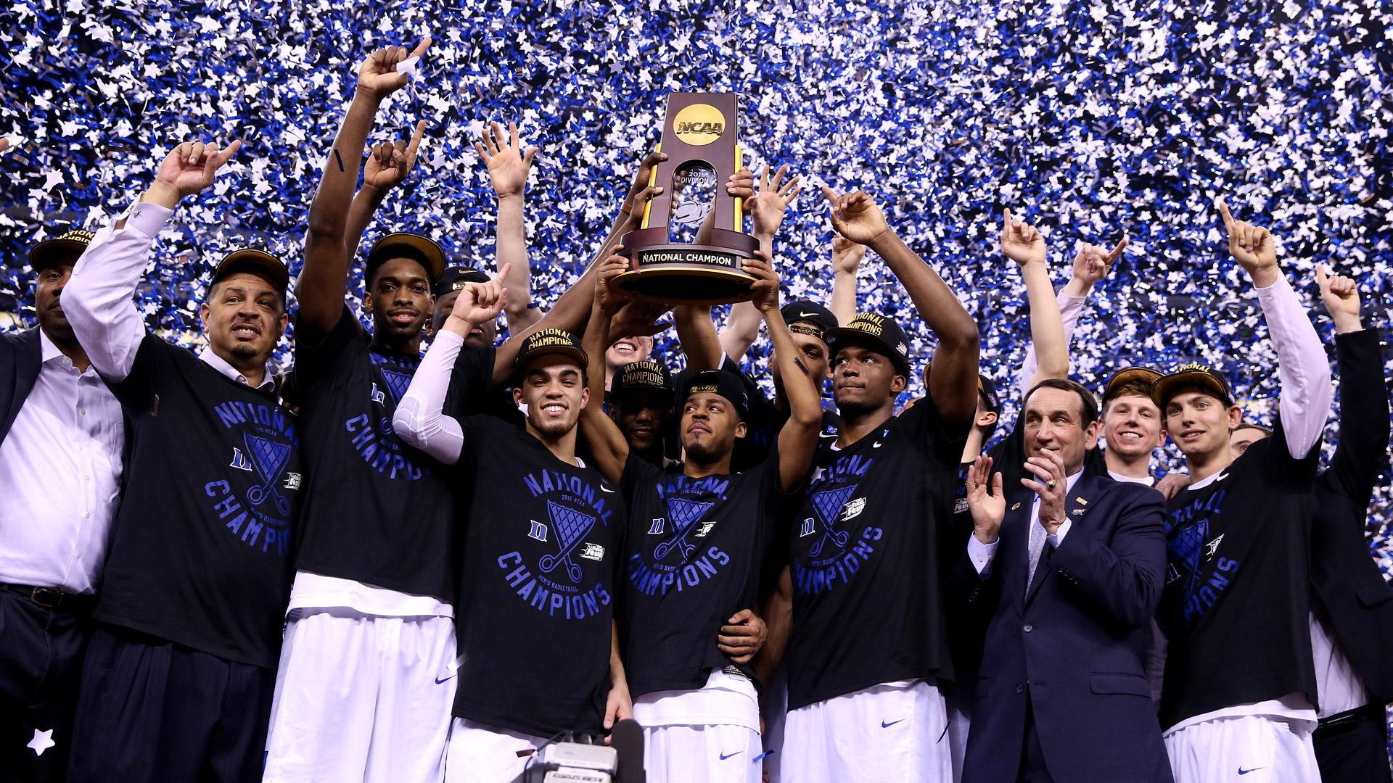
Tyus Jones Duke 2015 Scouting Report
Alex Jackson, Connor Aylett, and Jack Miller
*data from sports-reference
Notes:
Data was collected from sports reference

Slide 2
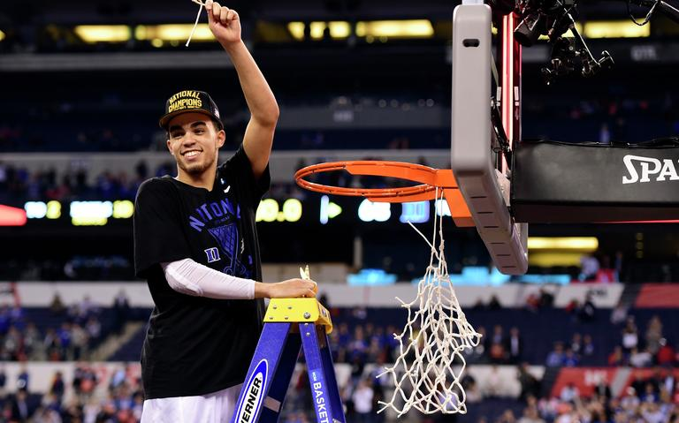
What are we analyzing?
We wanted to look at the most recent Duke basketball team that won a National Championship and figure out what made them special.
One person who truly propelled Duke’s 2014-15 NCAA Tournament run was Tyus Jones, the tournament’s Most Outstanding Player.
We decided to analyze Tyus Jones’ 2014-15 season and compare it to other recent championship point guards to determine what makes a championship team.

Slide 3
What made Tyus a good player?
NBA Draft Analysts described him as a player who is “not afraid to take on a larger scoring role when needed, seemed to play his best basketball in the biggest games” and is a “very confident player, never really seemed out of his element when faced with a challenge.” (https://www.nbadraft.net/players/tyus-jones/)
Our analysis explores this argument that Tyus was a so-called “big-game player,” while also attacking a separate exploration of Tyus’ contributions outside of scoring.
Notes:
As many know, following this season he was the 24th pick in the NBA Draft. He has finished top 10 in Ast/TO ratio every year since he’s been in the league, including being on his way to his fourth straight first place finish.
Additionally, we look at how he plays within the 2015 National Champion team and how he stacks up among other college point guards point guards.

Slide 4
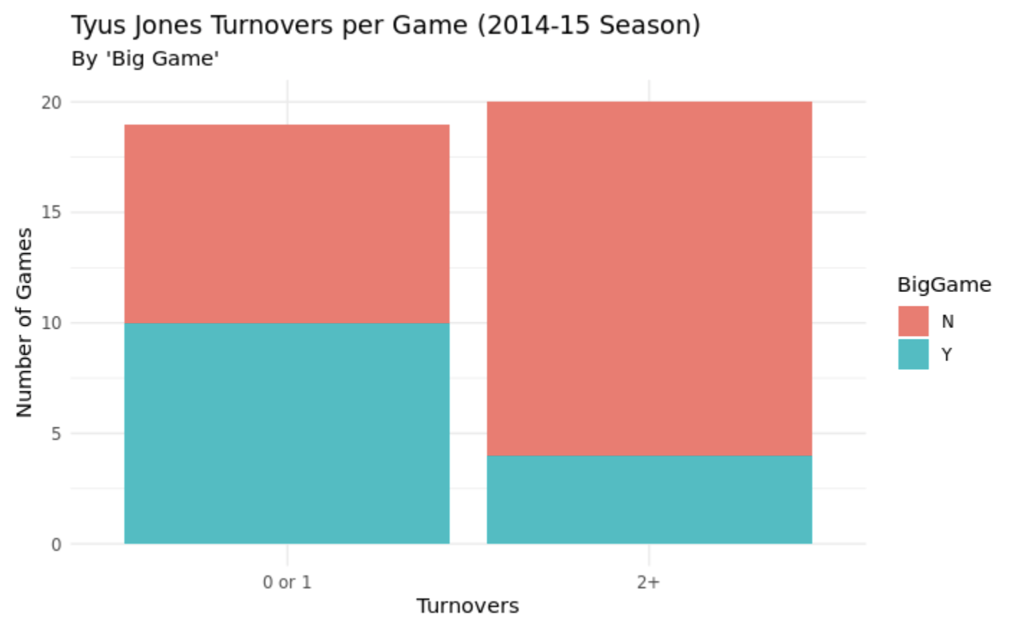
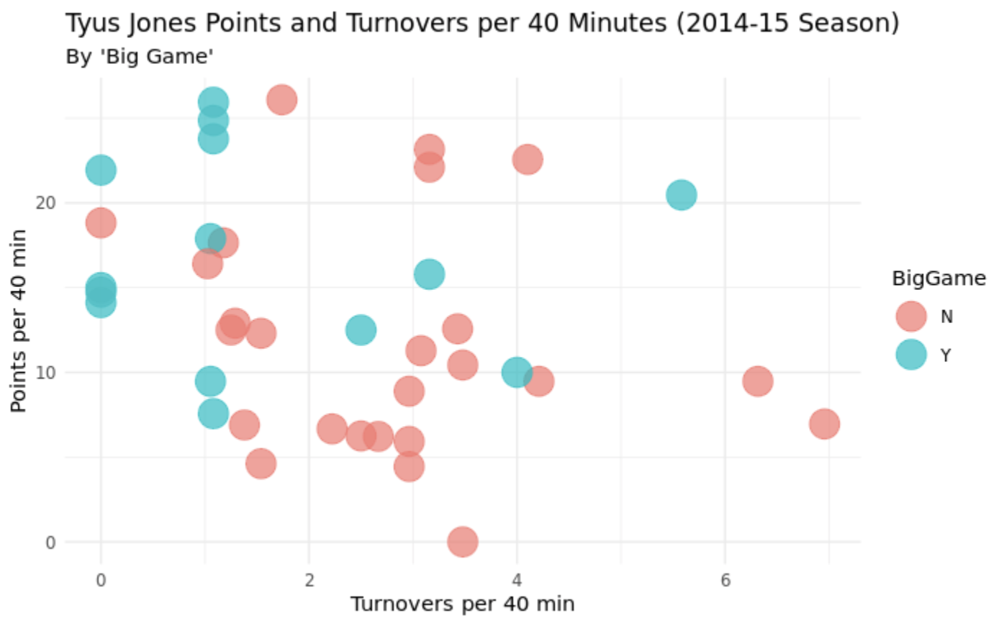
Big games, big performances
Data from Sports Reference
(we used points and turnovers per 40 minutes to account for minutes played across different games)
Notes:
We started by analyzing how Tyus performed in “big games” in the 2014-15 season and we defined this as games against AP Top 25 teams, ACC tournament games, and NCAA tournament games in the Sweet 16 and beyond
so as you can see Tyus had 19 total games with 1 or 0 turnovers and 20 games with 2 or more turnovers which means he had less than 2 turnovers in 48.7 percent of his total games. However, in big games, Tyus had 2 or less turnovers in 10 of his 14 games, or 71.4 percent, so this shows that Tyus really stepped up against his competition in terms of taking care of the ball against good competition

Slide 5
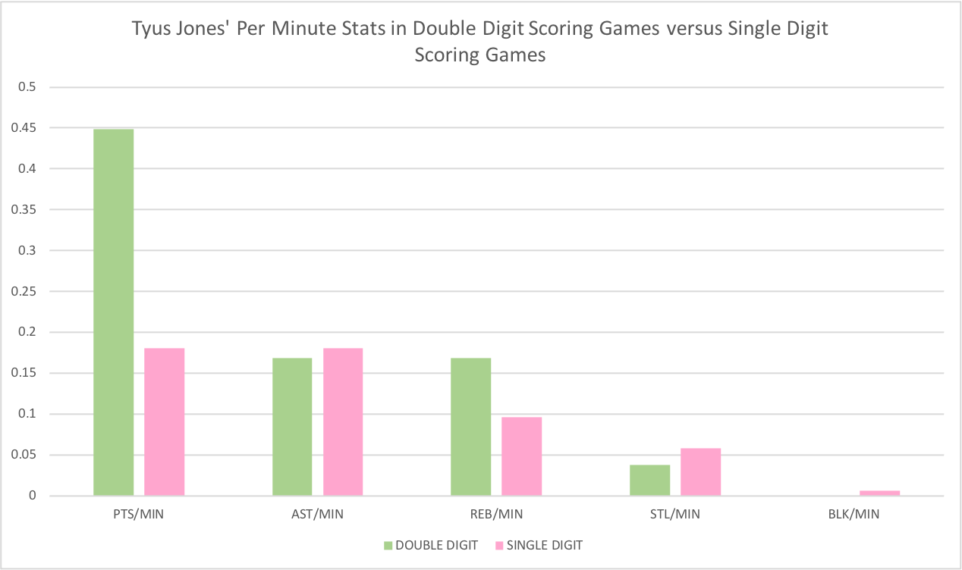
No scoring, no problem
As seen in the graph, Jones was able to keep his other impact stats relatively constant whether he was scoring in the single or double digits.
(per minute stats were used in order to counter single digit performances due to low minutes played in blowout games)
Data from Sports Reference
Notes:
Tyus Jones was never known to be the primary offensive option, yet he was able to impact the game without needing to put up big numbers in the scoring column.
Although he logged 23 double digit scoring outings in the 2014-2015 season, there were many games that Duke turned to someone else for points without Jones disappearing from the game.

Slide 6
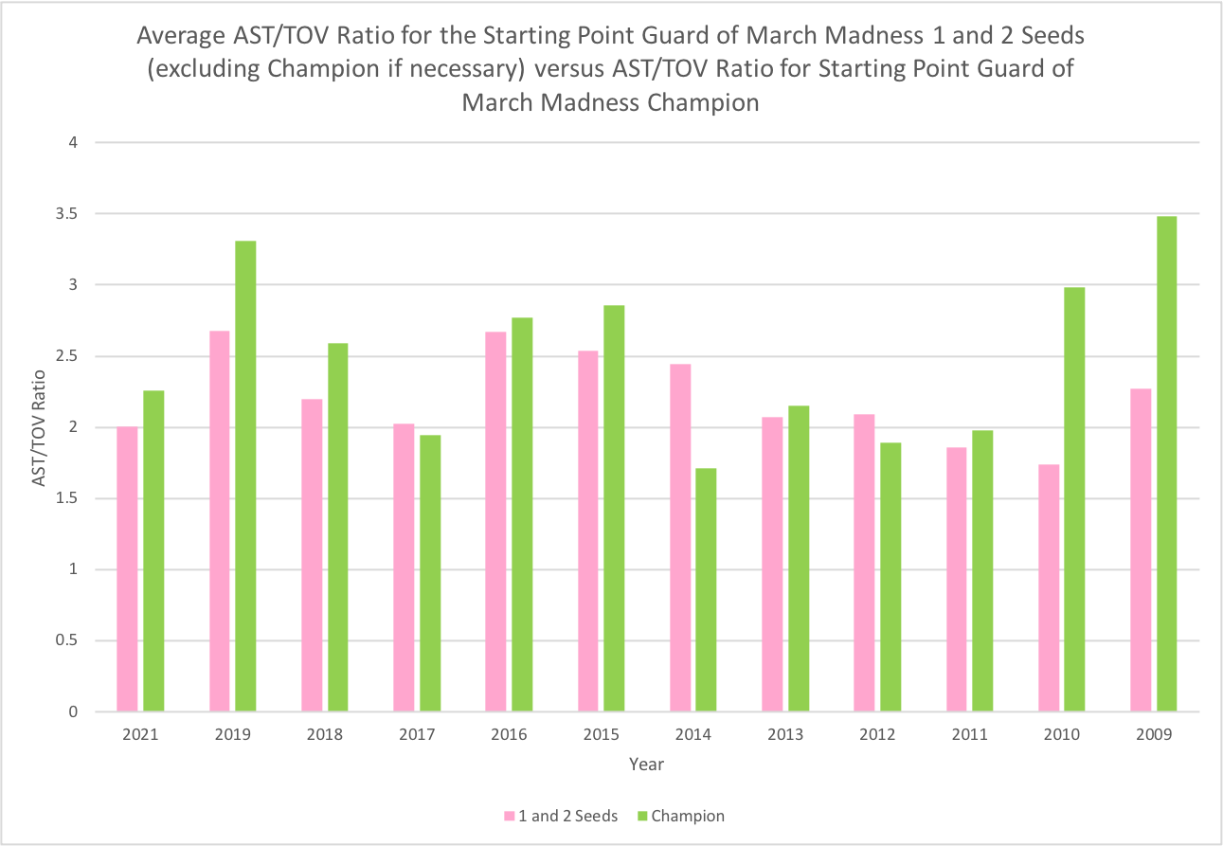
The Importance of Efficient Point Guard Passing in March
NCAA Tournament champion teams routinely feature elite and efficient passing from the point guard position
9 of last 12 March Madness winners’ starting point guards have fielded a higher AST/TOV ratio than the average point guard from the other 7-8 teams seeded 1 and 2
*data from sports-reference

Slide 7
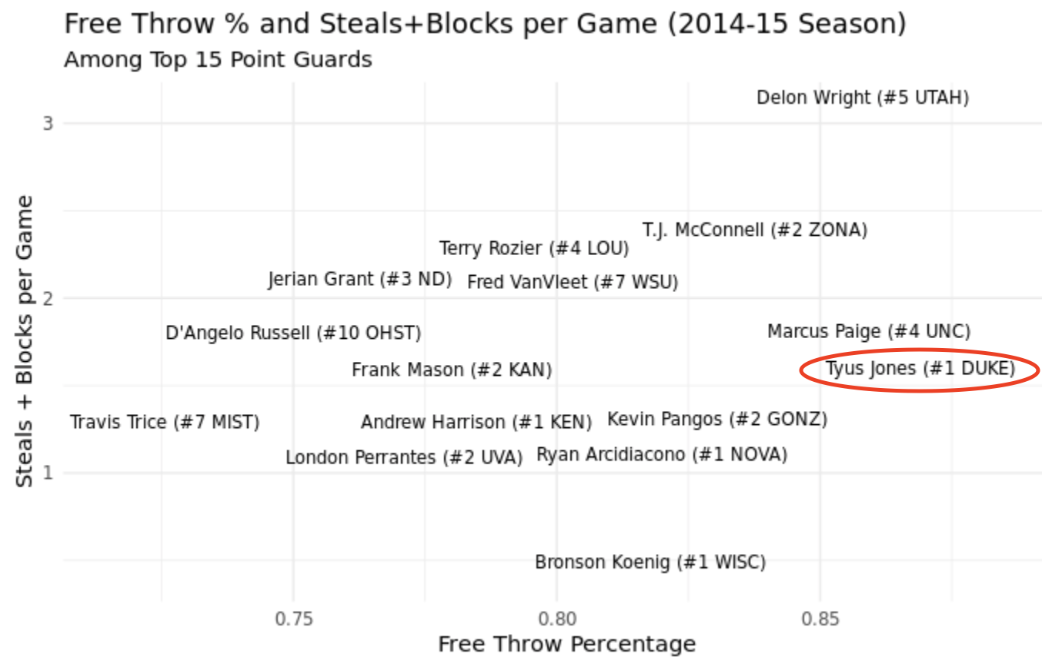
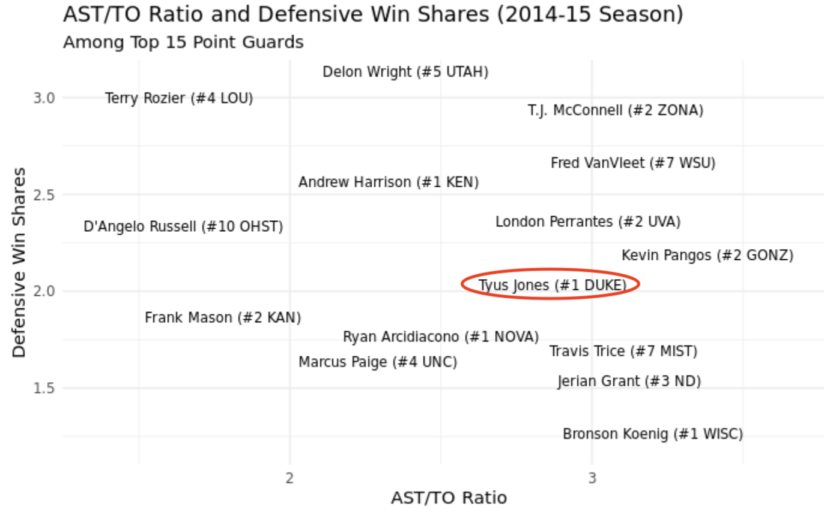
How Tyus Stacked Up to Elite PGs in 2015
Data from Sports Reference
Notes:
So we looked at how Tyus compared to other top point guards which were point guards from the 1 and 2 seeds as well as some other elite point guards that season and as you can see Tyus Jones had the highest free throw percentage of all the point guards we looked at which proved important in the national championship against wisconsin when we went 7/7 from the line
He also had an above average AST/TO ratio and ranked just below average in both Defensive win share and steals and blocks. While Tyus didnt put up elite numbers by any means and didnt have the individual numbers as some point guards such as T.J McConnell, Delon Wright, or Fred VanVleet, he certainly was one of the best point guards in the country for what he did

Slide 8
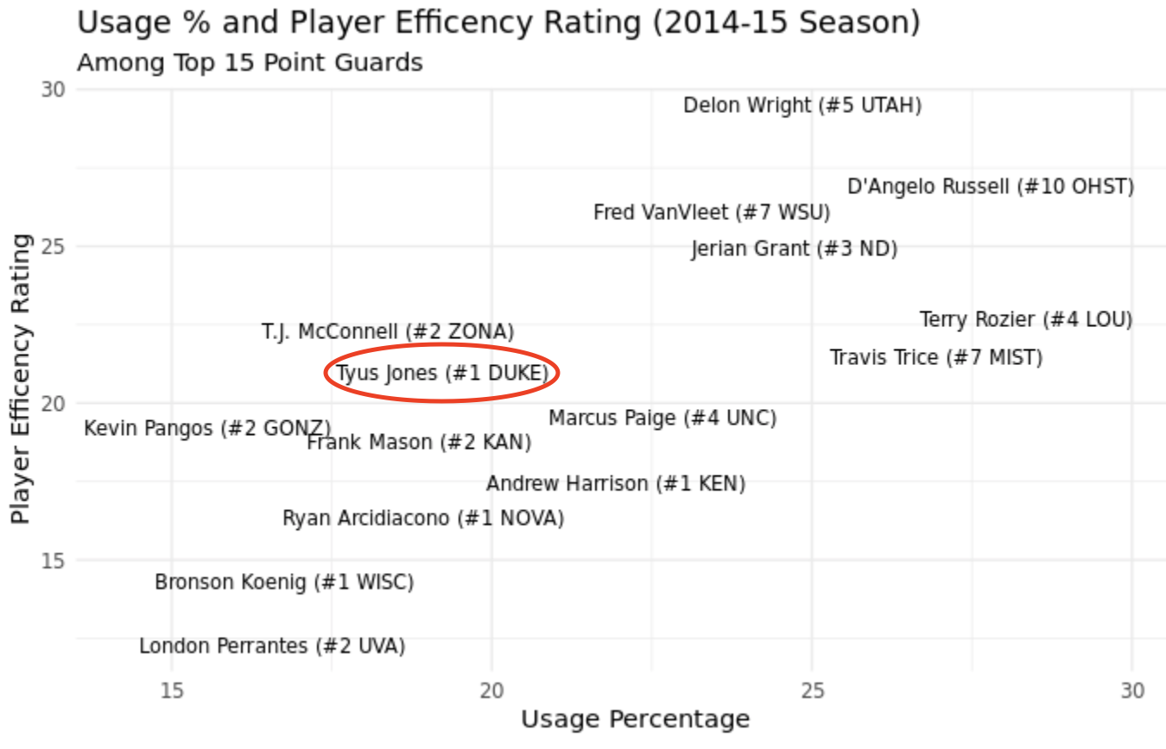
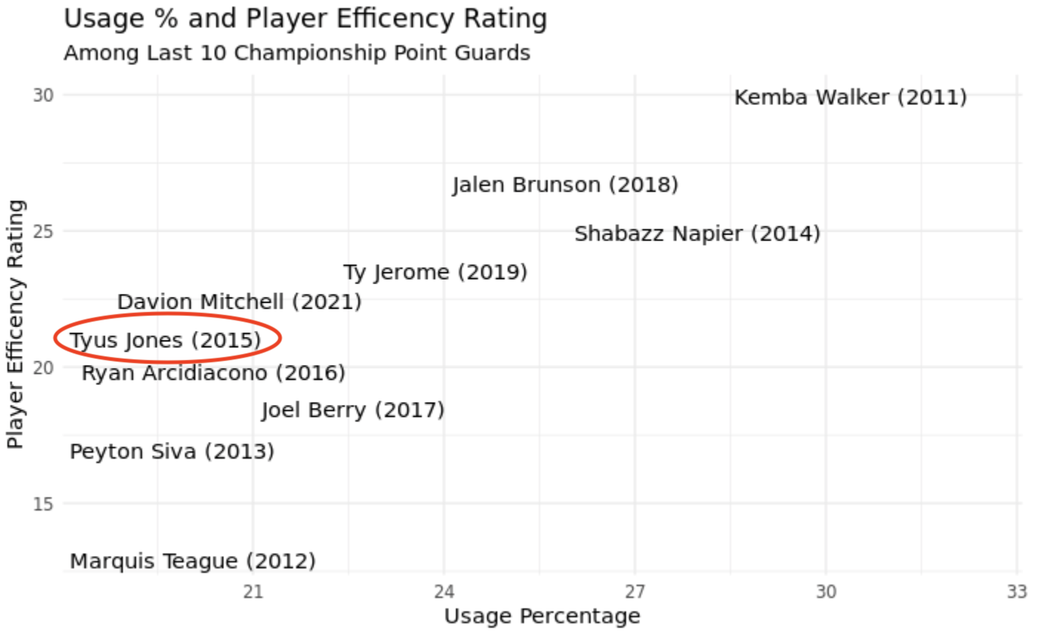
Not Doing it All Himself
Data from Sports Reference
Notes:
Going off that, While having elite point guard play is crucial in making deep NCAA tournament runs, a point guard can’t do everything alone so as you can see in the left graph Tyus Jones had one of the better seasons when comparing player efficiency rating to usage percentage which measures the percentage of the teams plays run through that player
So while point guards like delon wright, deangelo russell, and fred van vleet posted higher efficiency ratings than tyus jones, they also had much higher usage percentages. Only TJ Mcconnell had a higher PER given his usage rate, so because of the strength of Duke’s team Tyus wasnt asked to do a lot and although his efficiency numbers weren’t
The right graph shows how Tyus Jones compares against other recent championship point guards and while there are some point guards with a high usage percentage and player efficiency rating like kemba walker, the majority of the winning point guards are closer to Tyus Jones where they have a solid player efficiency rating but not a crazy high usage percentage

Slide 9
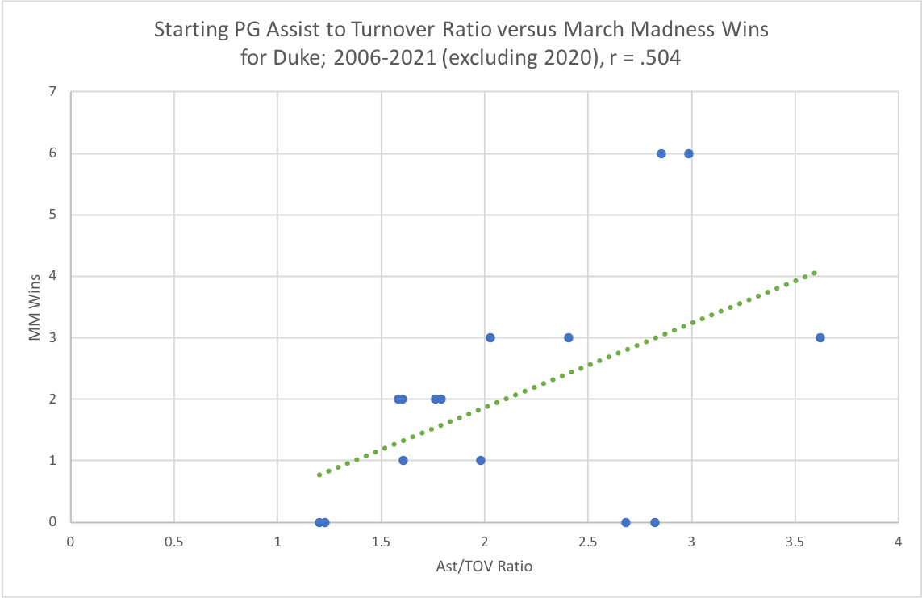
Duke’s Tournament Dependence on Efficient PG Passing
Positive correlation between starting point guard AST/TOV ratio and tournament success for last 15 Duke teams (exc. 2020)
Champion point guards Tyus Jones (2015) and Jon Scheyer (2010) have 2 of the top 3 ratios among Duke starting point guards since 2006
Seth Curry (2012) and Greg Paulus (2007) have the two lowest ratios, and their teams lost first round
*data from sports-reference

Slide 10
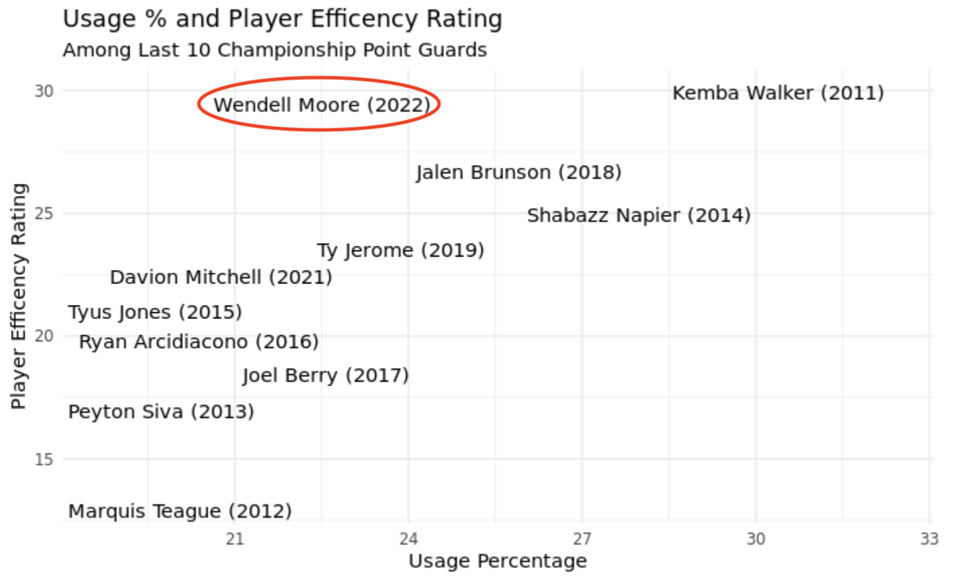
Conclusion
While winning a national championship is largely about luck, we have noticed that strong point guard play as long as the point guard isn’t the entire team
In addition, we found that Duke teams in particular rely on strong point guard play and leadership potentially due to the amount of freshmen around them.
Although it’s very early, Wendell Moore is stepping up and putting up numbers that would put him among the elite championship point guards in the last decade.
Data from Sports Reference

Slide 11
Sources
https://www.sports-reference.com/cbb/schools/duke/2015.html
Data from Sports Reference

